Slide 1
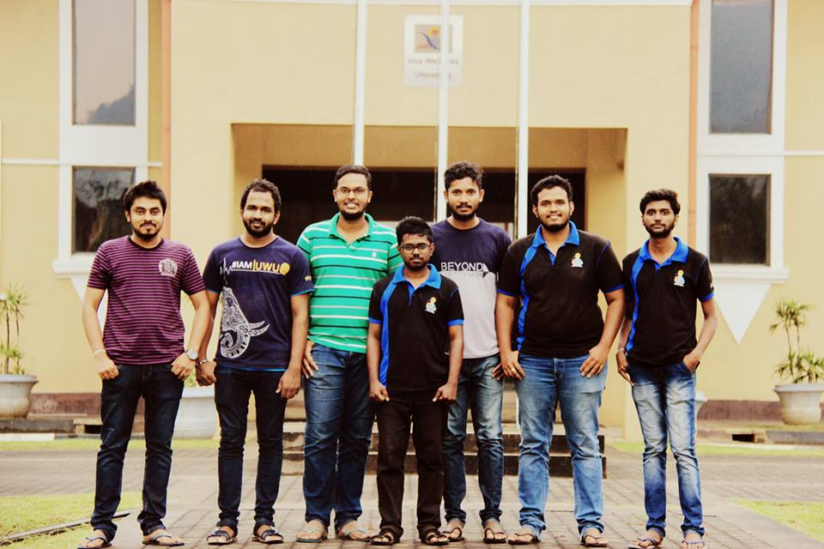
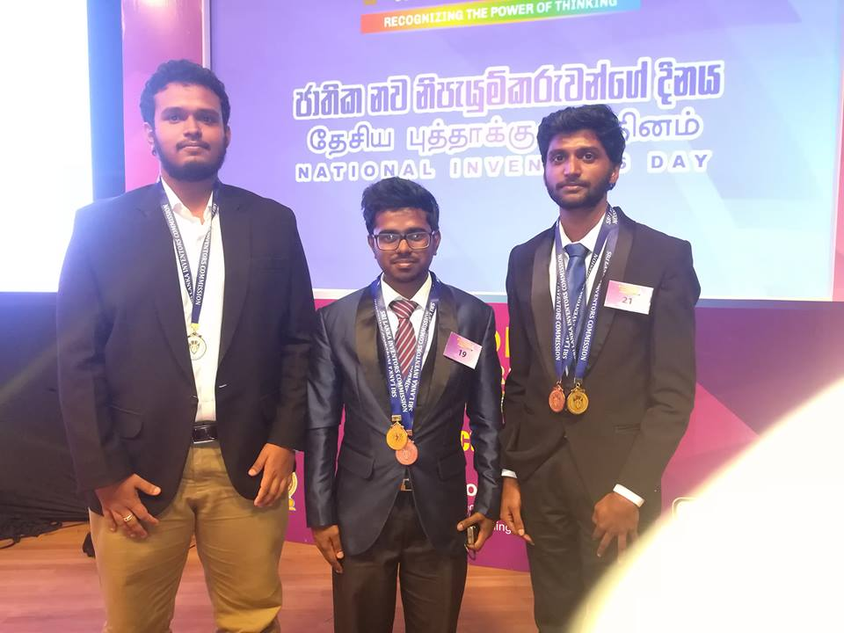
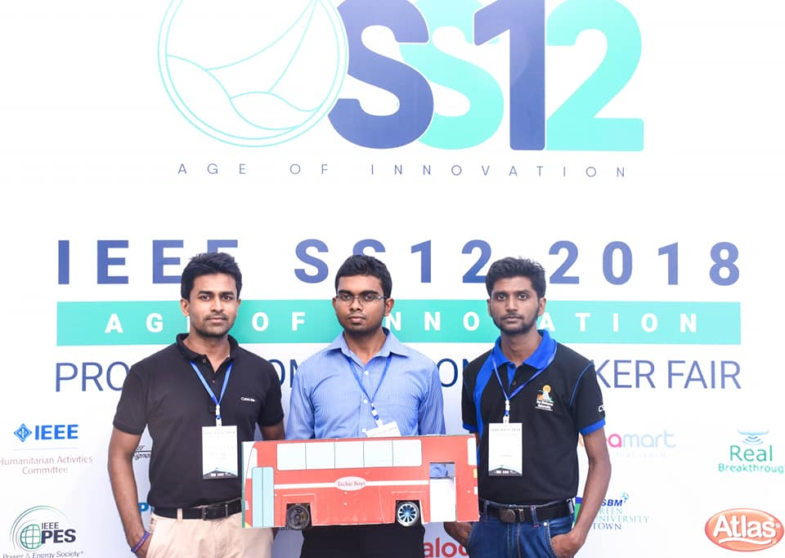
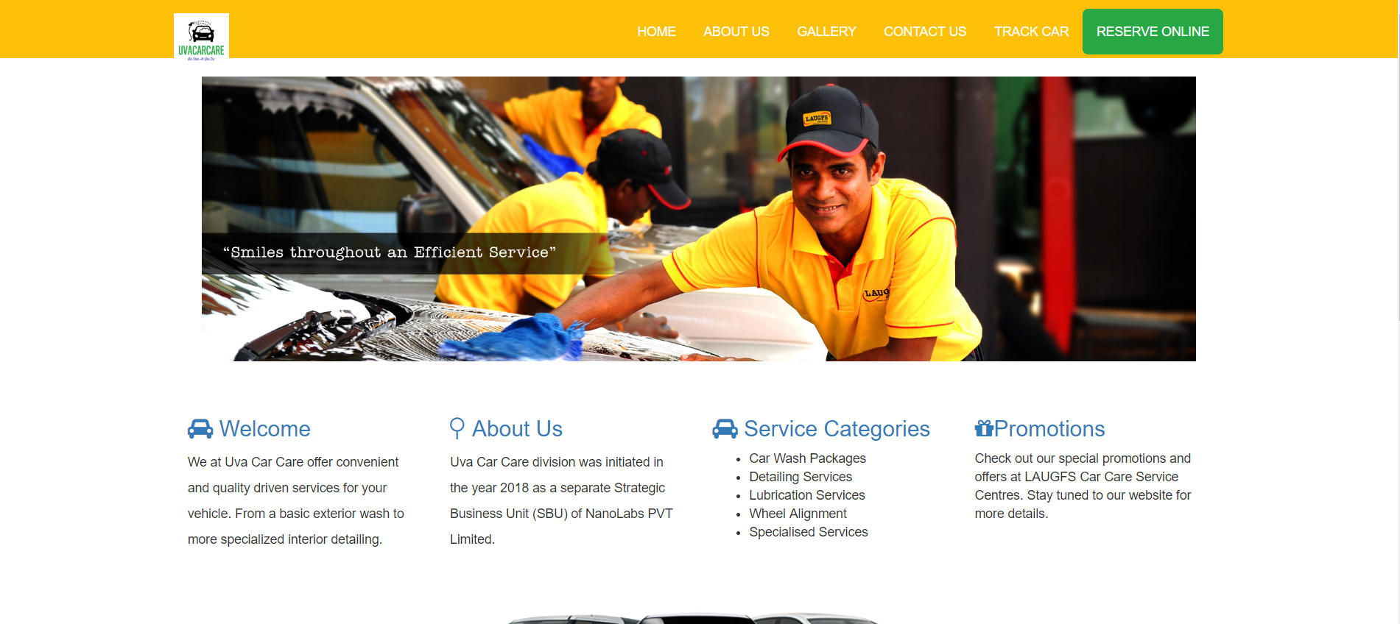
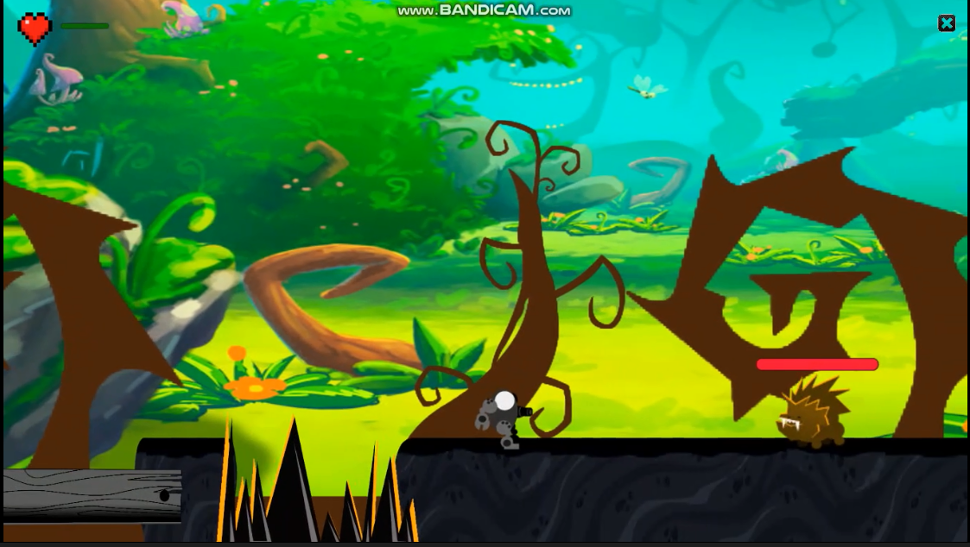
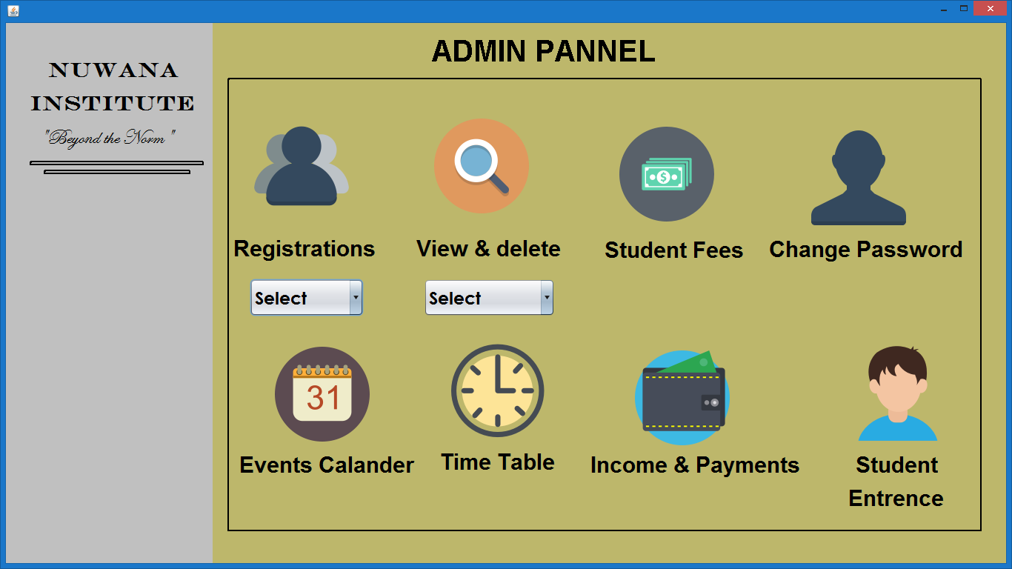
Projects Book
Randika Madhushan
Department of Computer Science and Informatics, Uva Wellassa University

Slide 2
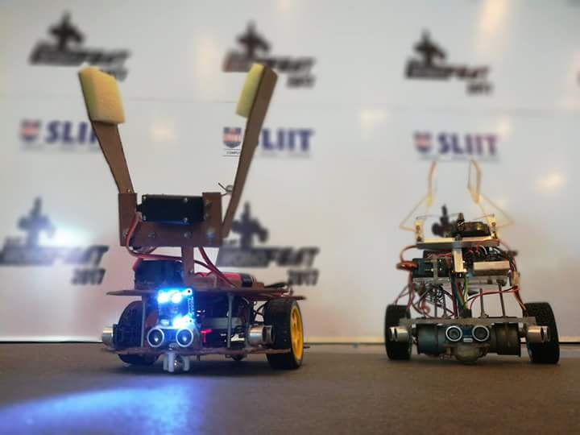
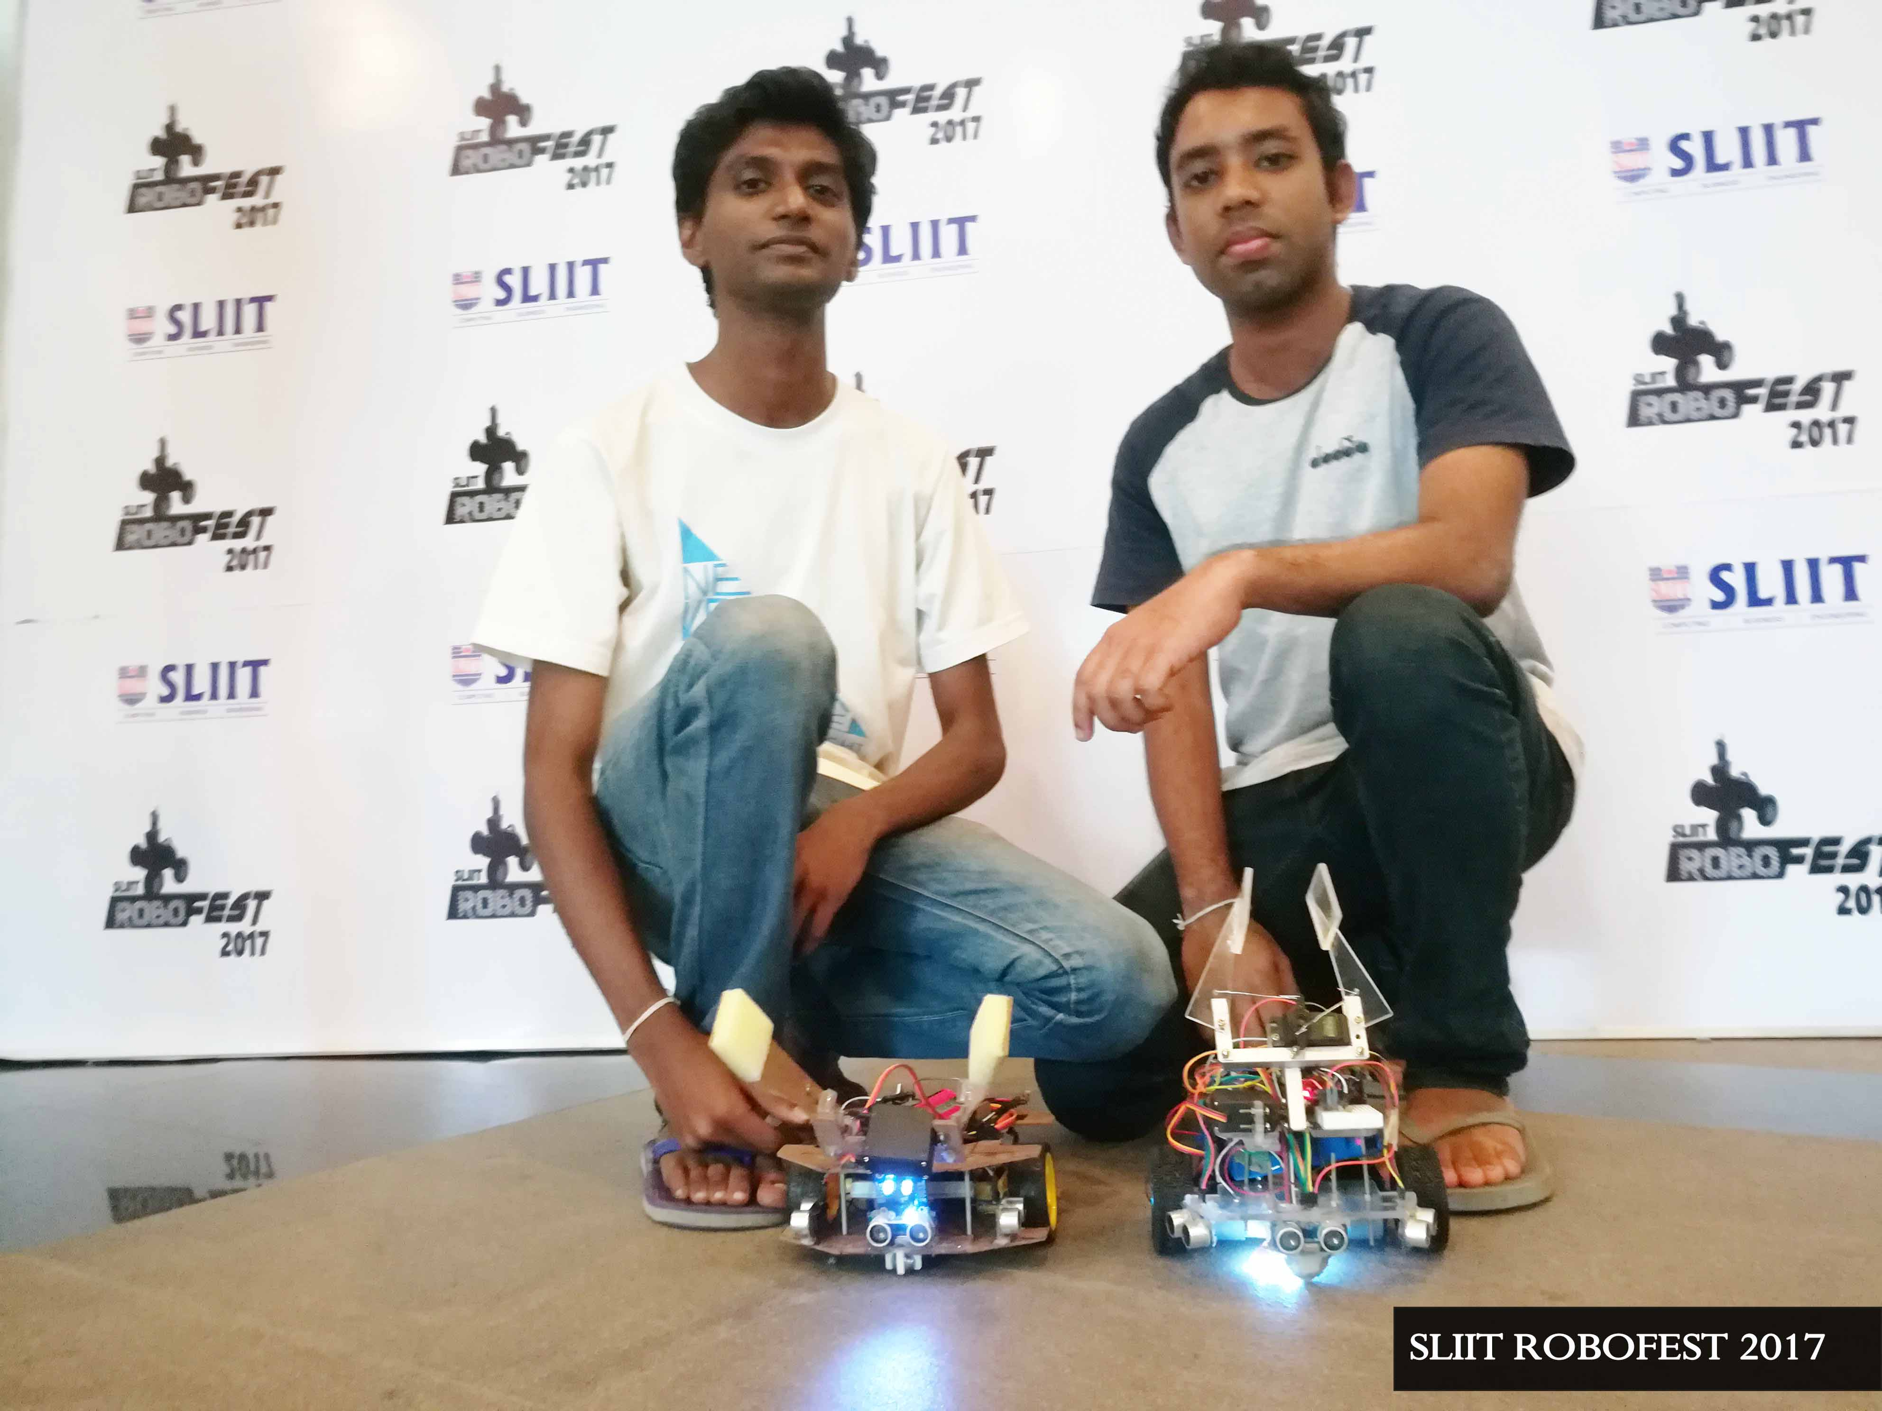
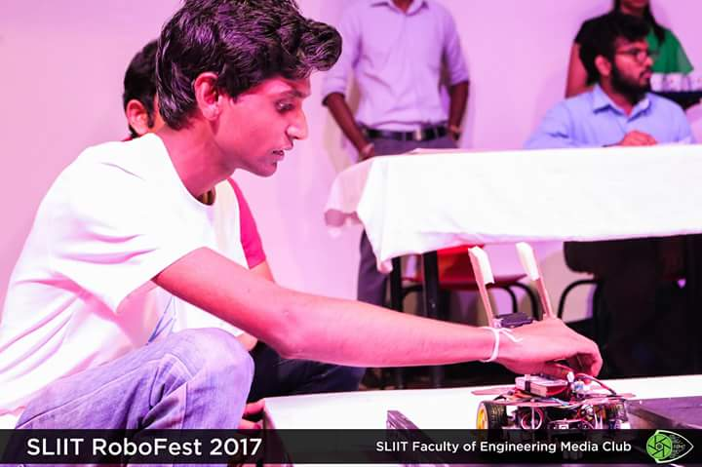
Project Name: FikBot – Maze Solving Robot
Year : 2017
Competition : SLIIT Robofest 2017
Used Technologies : Arduino , Sensors ( Color , ultrasonic ) , Maze Solving algorithms
Description : This robot is designed for grab objects with color detection , wall maze solving and going though the limited spaces.
What I learnt : Working with sensors , improved problem solving knowledge , team work , learnt to convert ideas into codes , working with limited time schedules.

Slide 3
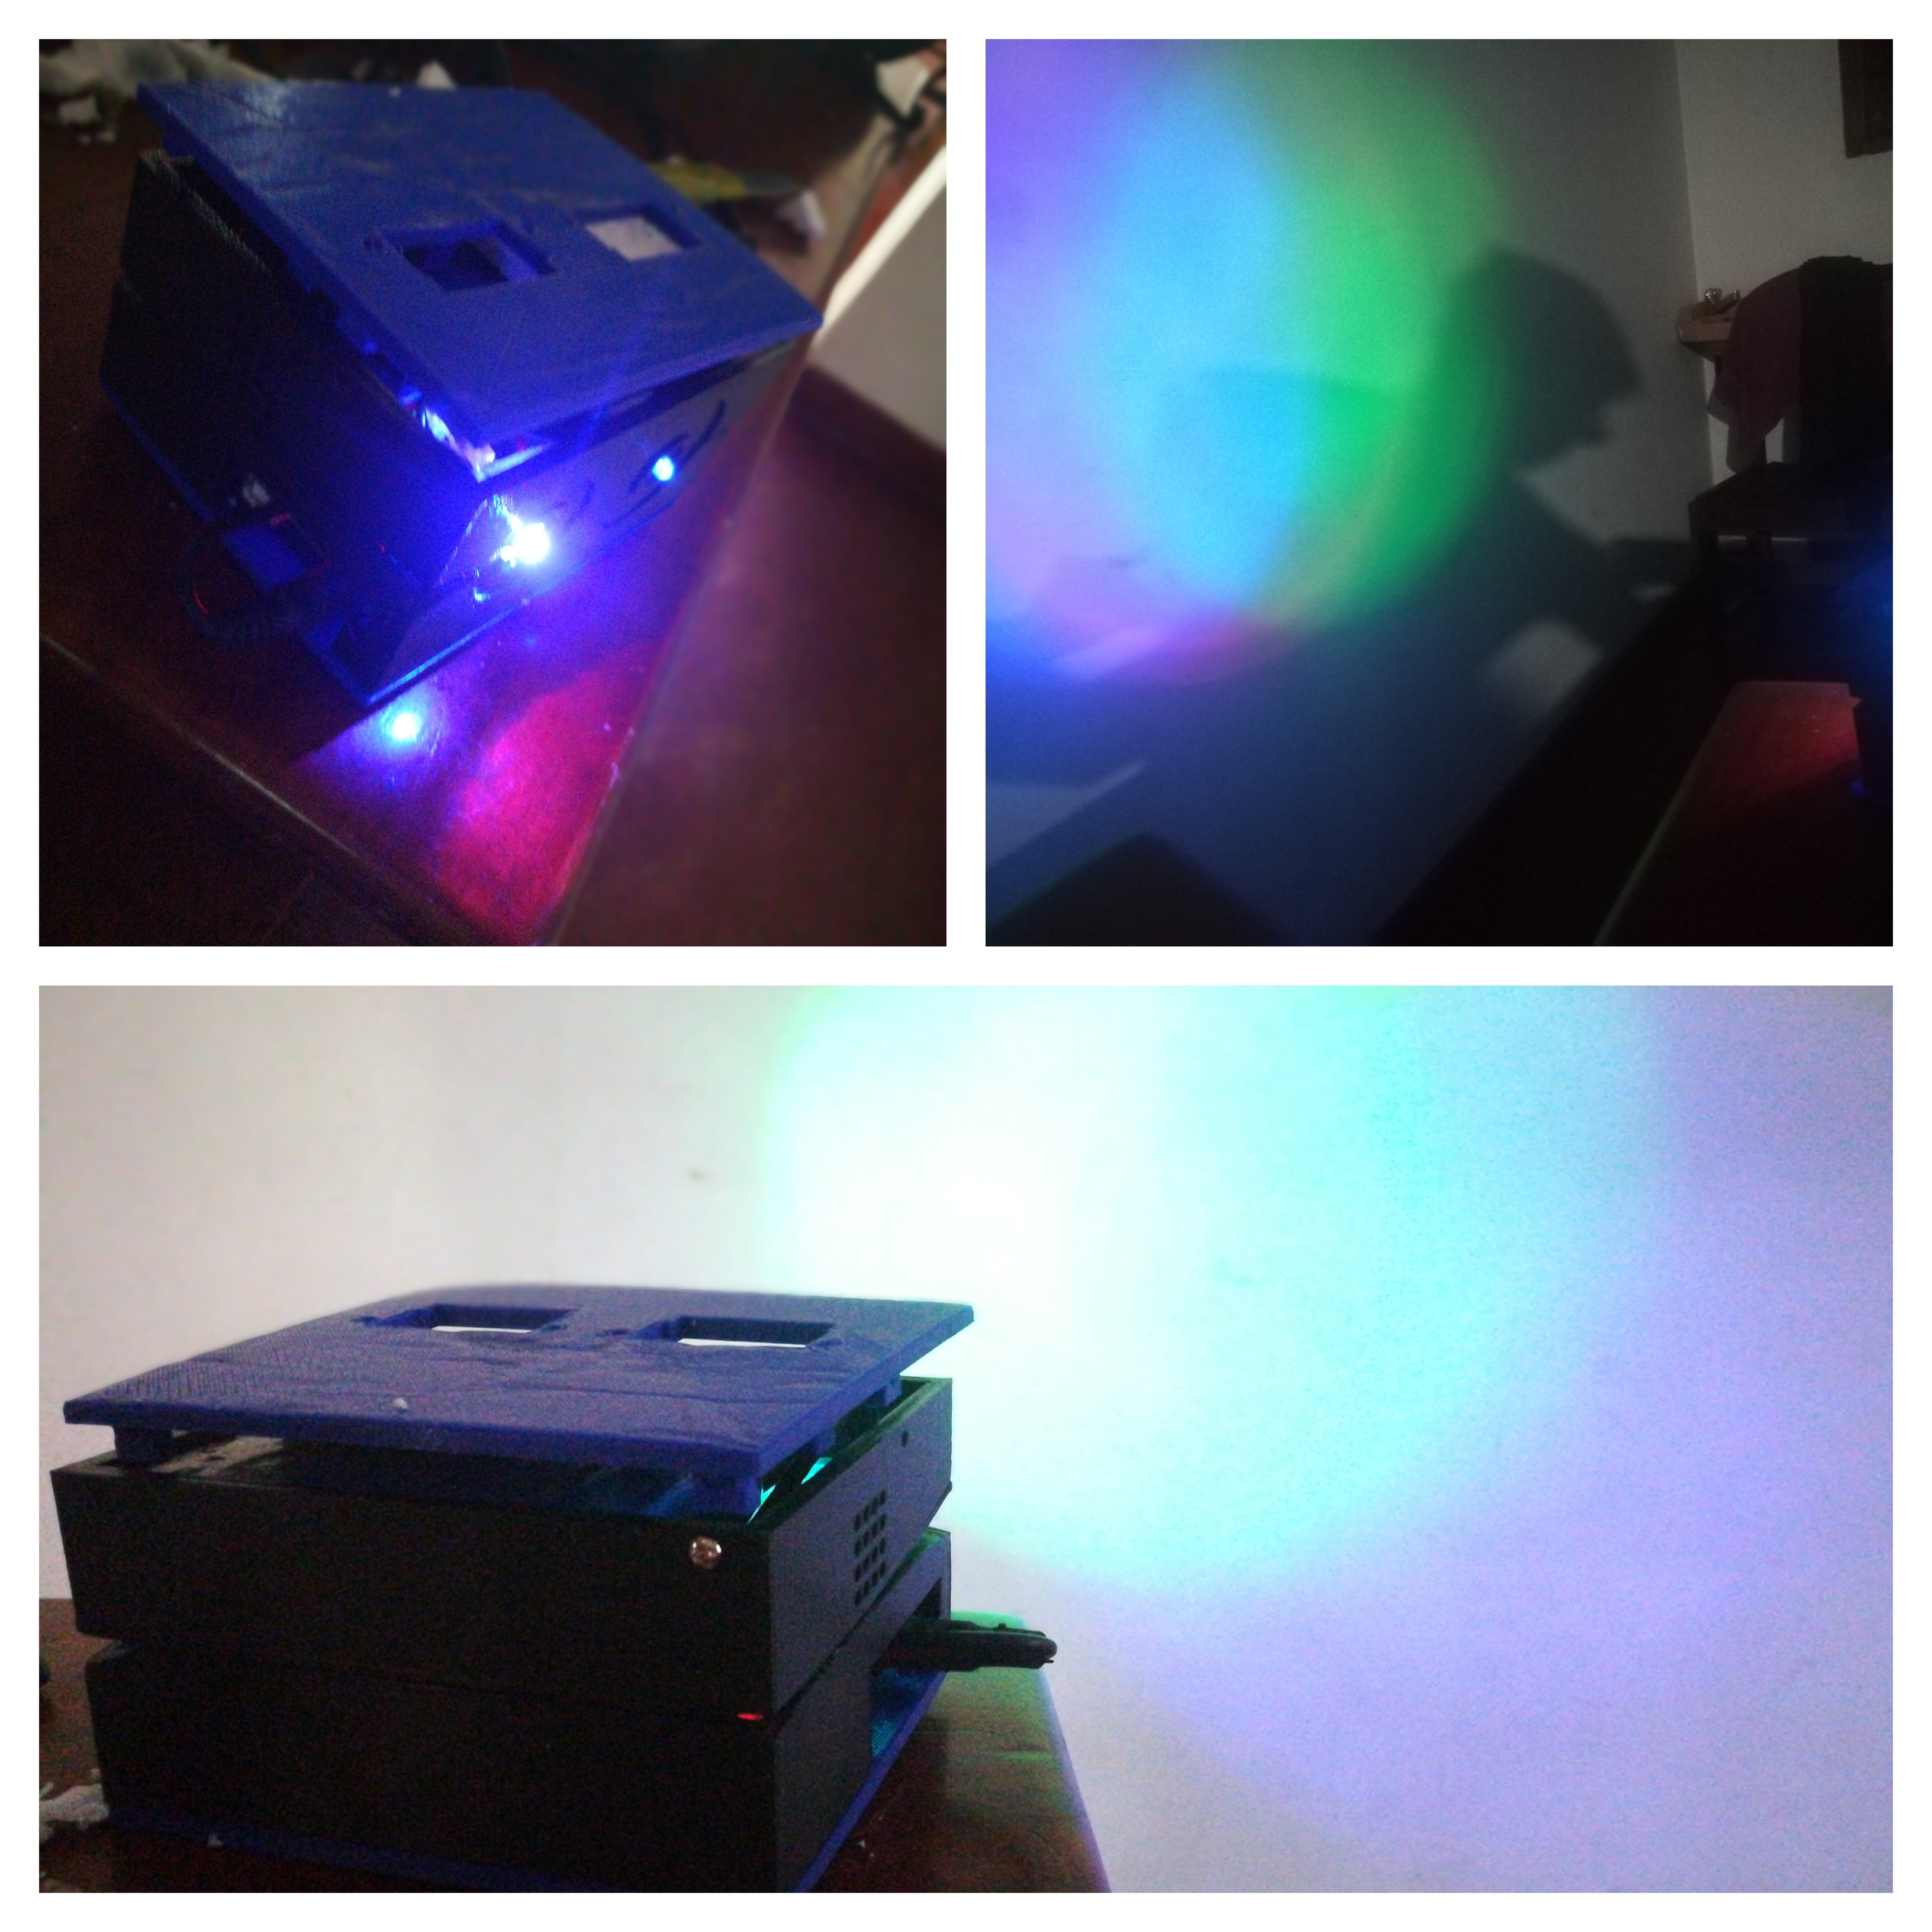
Project Name: “Amba Yaluwa” – The Concentration Device
Used Technologies: Arduino ,NodeMCU, C , Electronics
Description: A concentration device that based on psychology techniques (Color psychology , Pomodoro technique)
Awards : 3rd Place ( Bronze Medal ) in Applied Science & Technology , “Sahasak Nimeum” National Exhibition and Competition 2018 An Exhibition Organized by Sri Lanka Inventors Commission.
Merit Award - National Best Quality ICT Awards (NBQSA) 2018 Organized by British Computer Society (BCS) – The Chartered Institute for IT.
Finalist IEEE SS12 MakerFair South Asian Exhibition and Competition 2018 An innovations exhibition Organized by IEEE
What I learnt : Believing the ideas ,psychology techniques, prototyping, improving the version of an hardware project , 3D printing , working with interrupts in micro controllers.

Slide 4
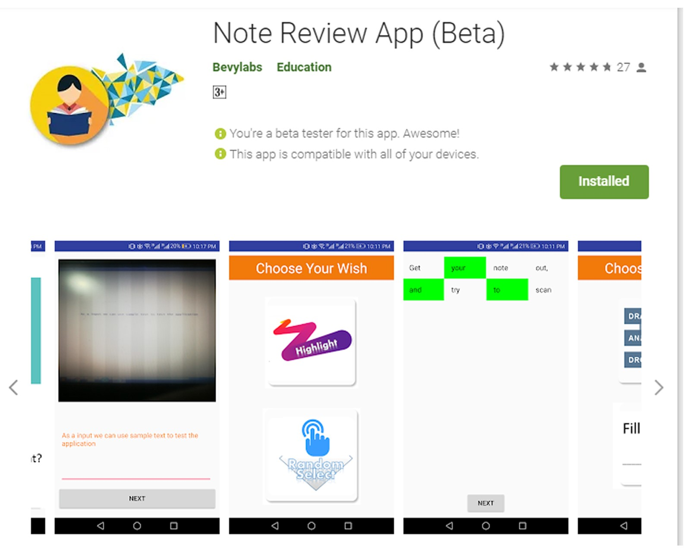
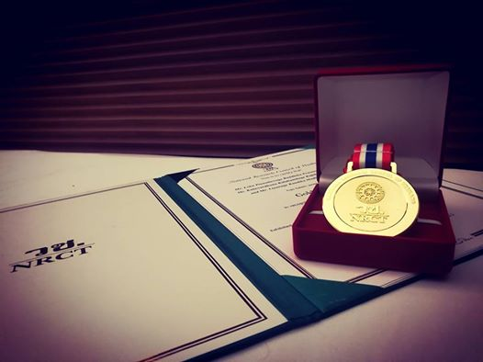
Project Name: NoteReview App
Competition : Sahasak Nimeum 2018
Used Technologies: Android Studio, Java, Google Vision API
Description: A solution for review notes and can evaluate the user in less than in 2mins.
Awards : Gold Medal - IPITEx 2019 (International Exhibition and Competition ) ,Bangkok International Intellectual Property Invention, Innovation and Technology Exposition. And a Special award from Indian Innovators Association 1st Place ( Gold Medal ) in ICT Category “Sahasak Nimeum” National Exhibition and Competition 2018 An Exhibition Organized by Sri Lanka Inventors Commission Project URL : play.google.com/store/apps/details?id=com.bevylabs.buddhika.notereview
What I learnt : Working with a team to achieve a goal. Convert ideas into code. Inspire others , 1st experience with android development / Google vision Api , Improving UI and UX in products , presentation skills , working with highly tied schedules, Gifts are impact for the people very much , Represent in an international competition as a Sri Lankan .

Slide 5
Project Name: Planet Adventure –PC Game
Competition : Uva Jam 2018
Used Technologies: Unity, C#.
Description: A 2D game designed for children to play at leisure time.
Project URL :https://randikam.itch.io/planet-adventure
Awards : 2nd place UWU Game Jam 2018 , A Game Hackathon Organized by Mozilla Campus Club - UWU.
What I learnt : To inspire others and get their skills on the stage , working with Unity engine , creative thinking, drawing.

Slide 6
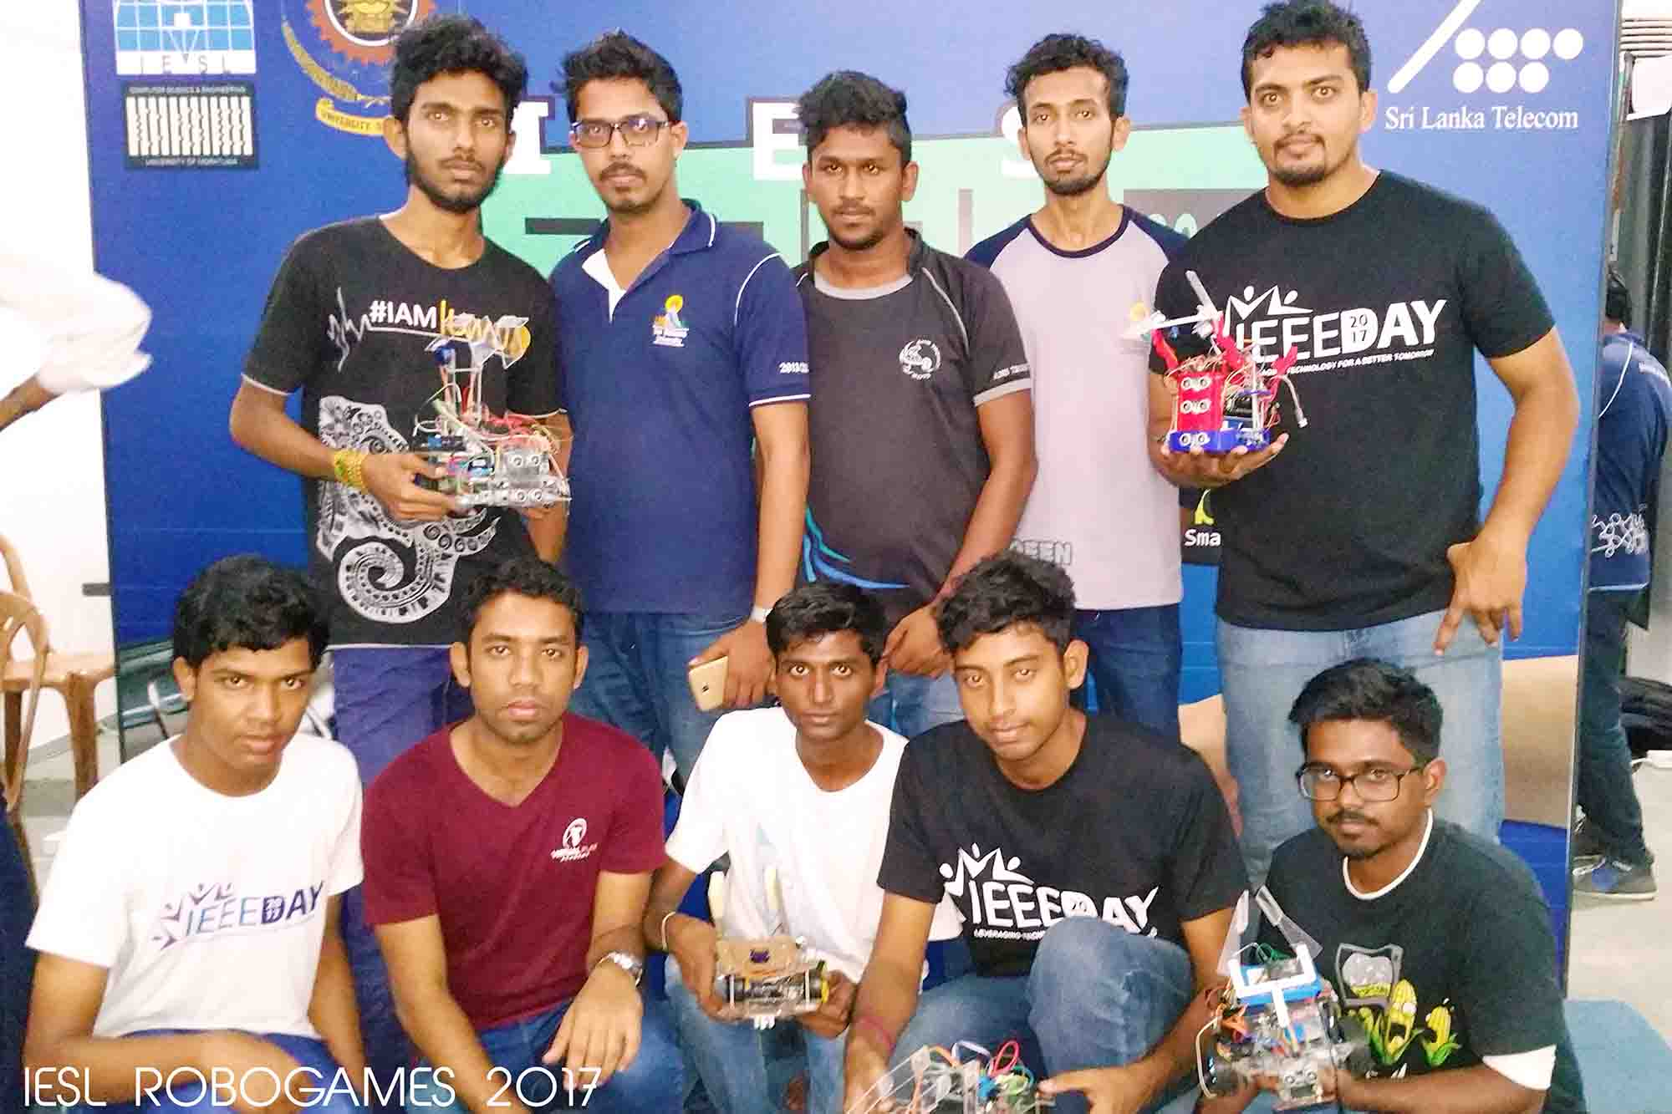
Project Name: FikBotV2
Competition : IESL Robogames 2017
Used Technologies : Arduino , Sensors ( Color , ultrasonic , IR)
Description : This robot is designed for grab objects with color detection , line maze solving and going though the limited spaces.
What I learnt : Working with sensors , improved problem solving knowledge , team work , learnt to convert ideas into codes , working with limited time schedules.

Slide 7
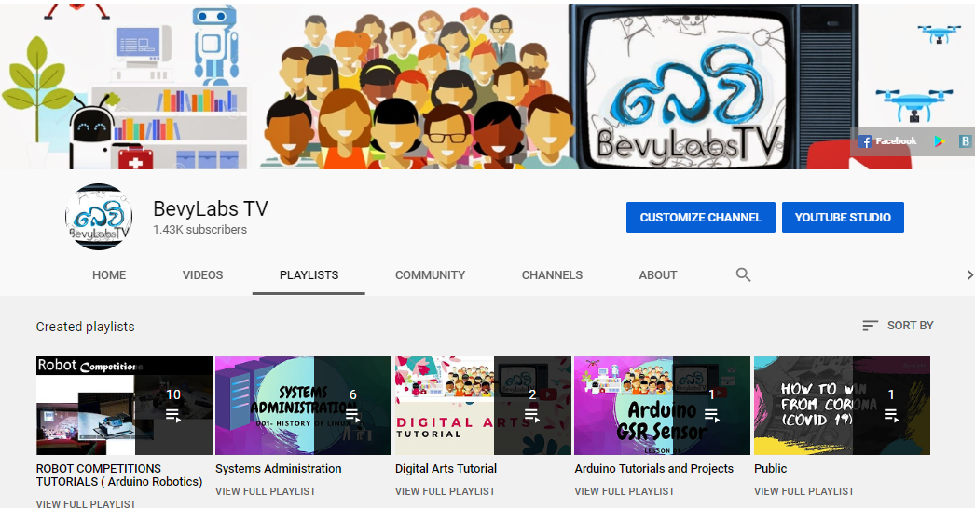
As a Youtuber / Contents Creator
I’m doing Systems Administration / Robotics Tutorials on YouTube with Bevylabs. I use it as a platform to share my knowledge to the world. Recently it has over 1000 subscribers from all over the world.

Slide 8
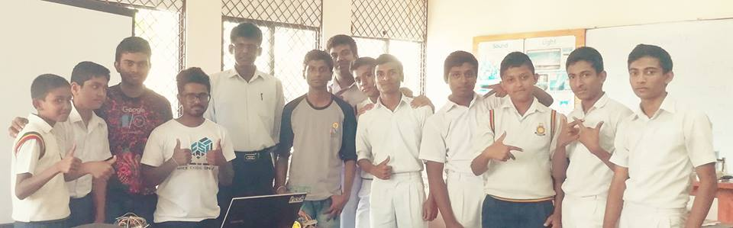
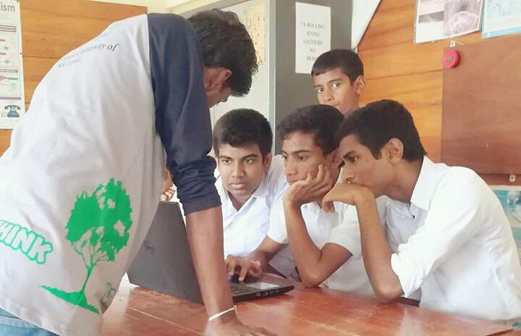
As a Resource person for workshops
I and my team conducted several workshops about how preparing for robotics competitions and some motivational sessions to inspire the students to achieve their goals. Also, we got many positive feedbacks on our workshops.

